Slide 1
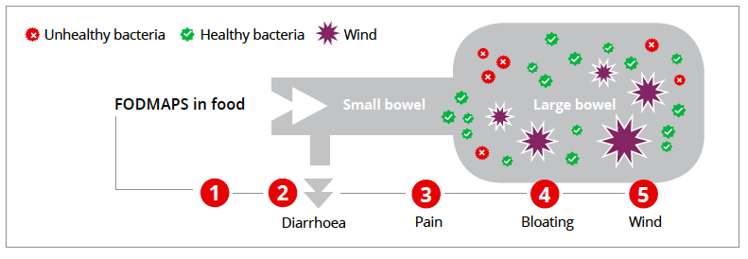
Figure 1: Mechanism of action of short-chain fermentable carbohydrates in the bowel⁹
* FODMAPs – Fermentable Oligosaccharides, Disaccharides, Monosaccharides and Polyols
1.FODMAPs* enter the small bowel.
2.If undigested, due to an enzyme shortage (e.g lactase) or lack of suitable fructose transporter mechanisms . FODMAPs cause an osmotic shift in the ileum drawing excess fluid into bowel softening the stool.
3. Triggering visceral hypersensitivity and subsequent pain.
4- 5 Undigested FODMAPs *reach the large bowel where they are fermented by luminal bacteria producing increased methane, hydrogen and carbon dioxide triggering luminal distension, increased pain, wind and bloating.
Additional cellular impact - Immune modulation – increased mast cell activation.

Slide 2
Figure 2: IBS Dietary Treatment Pathway^{2, 5, 8}
INITIAL ASSESMENT
Symptom Severity Score
Bristol Stool Chart
Dietary History
Check known triggers – lactose, fibre, fat, caffeine, alcohol
FIRST LINE DIETARY THERAPY
Balanced healthy eating
Eating patterns , habits and routines
Healthy Fluid Advice
Lifestyle Modification – exercise, stress relief , relaxation
SECOND LINE DIETARY THERAPY
FODMAP elimination
FODMAP re-challenge
FIBRE MODIFICATION
THIRD LINE DIETARY THERAPY
Modified long term FODMAP Diet
Probiotics supplementation
Other Allergy – elimination and re- challenge

Slide 3
Figure 3: Ms. A - Change in symptom severity throughout the dietary process

